Slide 1

Hackathon on Twitter Dataset Sentiment Analysis
Team : WeGotThis!
Team Members -
Atharva
Aishawarya
Revathi
Priyanka

Slide 2
Problem Statement
From a given set of tweets , analyze the sentiment of the tweet and predict a sentiment score for that tweet
The different set of sentiments provided are 0: Negative 1:Neutral 2: Positive 3 : Cannot Determine

Slide 3
About Twitter :
Twitter is a social media platform where millions of users tweet about various different topics and interact with each other
Any given user only has a limit of 280 characters to express themselves.
Along with words users can use hashtags (eg- #GreyAtom) to help other users find tweets with similar interests and topics.
Due to the limit of characters users also use shorter words and emojis to express their feelings.
Users can also mention other users using ‘@’ so that they can communicate with each other.

Slide 4
Twitter Data analysis using NLP:
To solve the given problem statement we need to analyze the data from different tweets using Natural Language Processing (NLP).
NLP is a technique used to help the computer and machines understand the language the we speak and write in our day to day life.
NLP is used to extract features from text to be used for supervised and unsupervised machine learning problems.

Slide 5
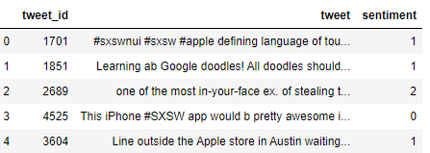
Dataset
The dataset given to us for analysis consists of three features :
Tweet_id : ID of a particular tweet
Tweet : Text data of the tweet
Sentiment : Sentiment score of the tweet.

Slide 6
Evaluation Metric :
The evaluation metric given for our problem is the weighted F1- score
F1-score is the weighted average of precision and recall.
It takes both false positives and false negatives into account.
The formula for F1 score is given by F1 score = 2*(Recall*Precision)/(Recall + Precision).

Slide 7
Challenges with this dataset:
The text data of a tweet is complex as users use hashtags, emojis and shortforms to express themselves.
Tweets can also contain various links as well as numbers .
As the data isn’t monitered , this can lead to a lot of spelling errors which can be difficult while using nlp

Slide 8
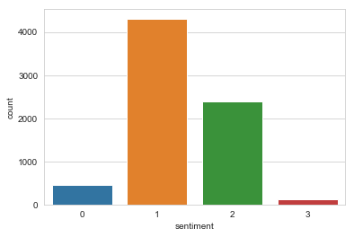
Exploratory Data Analysis:
From the graph we can see the count of each class.
0 – 6 %
1 – 59%
2- 32 %
3 – 3 %

Slide 9
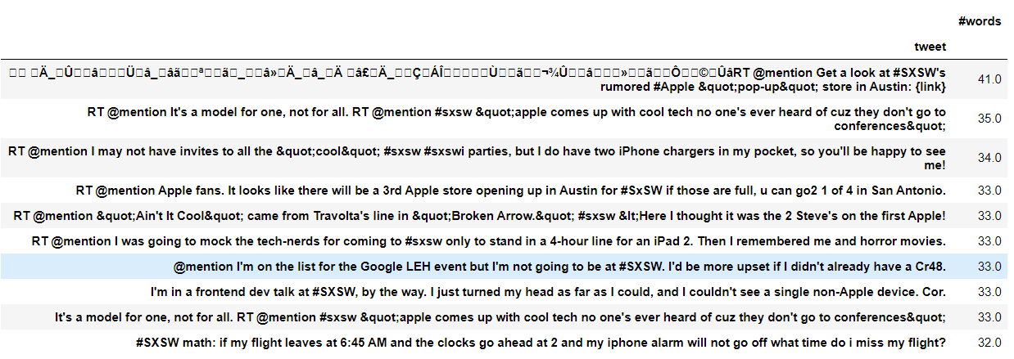
Top 10 longest tweets :

Slide 10
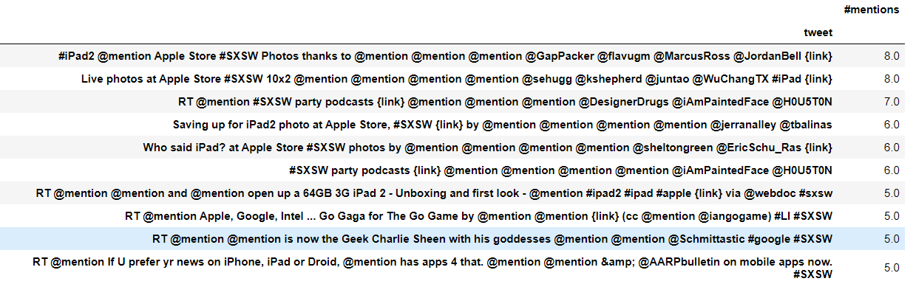
Top 10 tweets with most mentions:

Slide 11
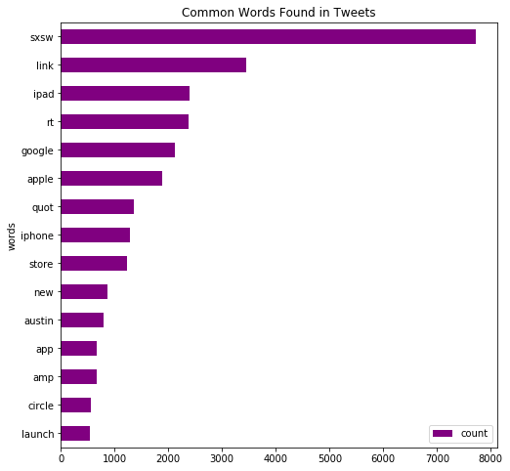
MOST COMMON WORDS IN TWEETS
From the Graph we can see that the most common words are –
Sxsw
Link
Ipad
Rt
Google
Apple
Quote
Iphone
Store
new

Slide 12
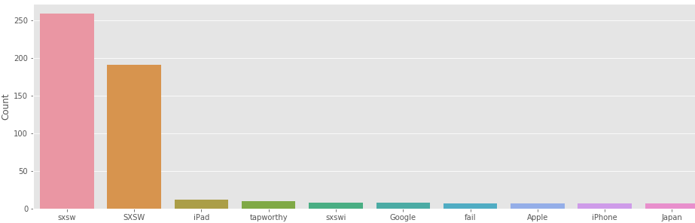
MOST NUMBER OF HASHTAGS IN TWEETS WITH A SENTIMENT SCORE 0:
NEGATIVE TWEETS

Slide 13
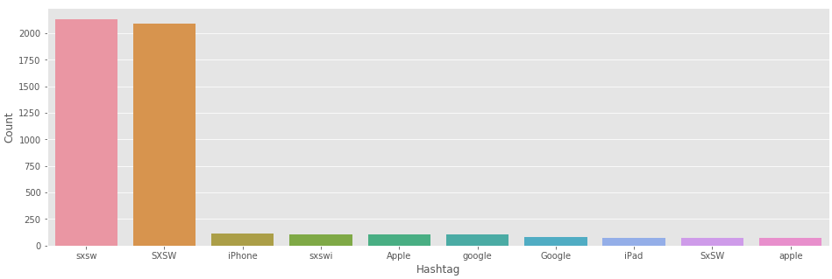
MOST NUMBER OF HASHTAGS IN TWEETS WITH A SENTIMENT SCORE 1 :
NEUTRAL TWEETS

Slide 14
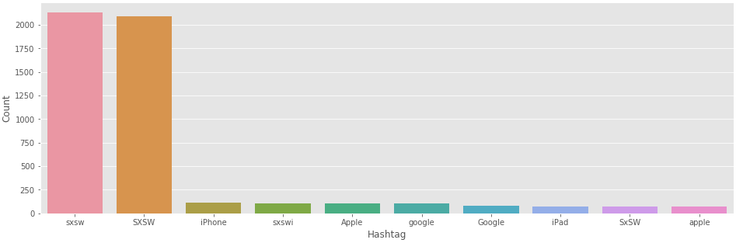
MOST NUMBER OF HASHTAGS IN TWEETS WITH A SENTIMENT SCORE 2 : POSITIVE TWEETS

Slide 15
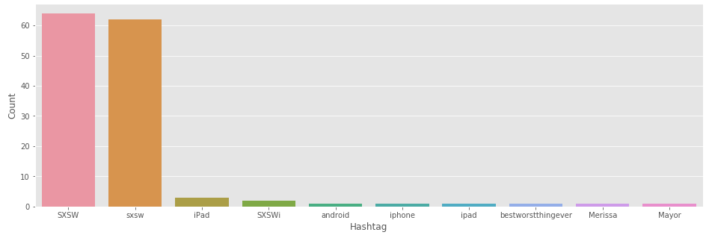
MOST NUMBER OF HASHTAGS IN TWEETS WITH A SENTIMENT SCORE 3:
CANNOT SAY

Slide 16
INFERENCES FROM EDA:
There is a slight class imbalance in the dataset.
Most common words in the text data are related to brands like apple and google which indicate that the there are a lot of brand reviews
Upon analyzing different graphs of the hashtags that occur frequently, we understand that #sxsw was the most common hashtag .
Upon learning more about SXSW we came to know that it a festival ‘South by Southwest which takes place in USA .

Slide 17
TEXT PRE-PROCESSING :
To be able to use the raw data from the tweets we need to perform some preprocessing on the ‘tweet’ feature from the dataset.
We used the nltk library in python for pre-processing.
The pre-processing steps were as follows:
Removing ‘#’ , punctuations , url’s and other special characters from the tweets.
Replacing any digits in the tweets with ‘number’
Lower casing all the words in the tweets and removing whitespaces.
Removing stopwords.
Stemming words into their root form using LancasterStemmer.
Tokenizing words from tweets in tokens using nltk.

Slide 18
FEATURES CREATED AFTER PRE-PROCESSING:
We created the following features from the data after pre-processing:
Number of words per Tweet
Number of hashtags per Tweet
Hashtags in each Tweet.
Number of mentions per Tweet.
Number of links or url’s per Tweet.

Slide 19
Vectorization:
We used the Term Frequency-Inverse Document Frequency (TF-IDF) vectorizer.
TF-IDF is a vectorizer that transforms text to feature vectors which can be used to help build and train our models.
TF-IDF gives the product of the ratio of the number of times a word appears in a document to the total terms in the document and the log of the ratio of the total number of documents to the number of documents with the word in it.
Advantages of TF-IDF are that it is easy to compute and can extract the most descriptive terms in a document.
We tuned the hyper-parameters so that we could keep the n-gram range of (1,2) so that we can capture bi-grams in the text.

Slide 20
MODELS AND SCORES:
The different models that we used for our predictions were:
RandomForestClassifier
NaiveBayesClassifier
Linear SVC

Slide 21
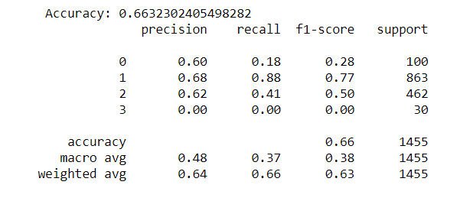
RESULTS: RANDOM FOREST CLASSIFIER

Slide 22
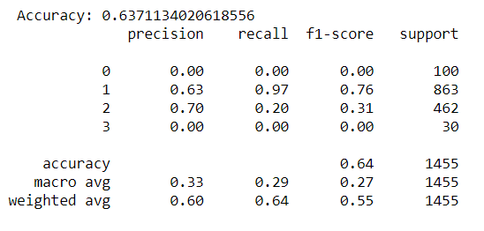
RESULTS: NAIVEBAYES CLASSIFIER

Slide 23
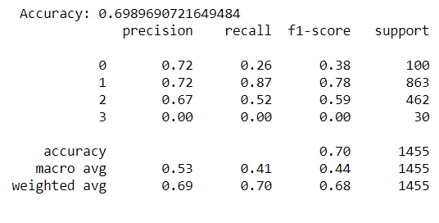
RESULTS : LINEAR SVC

Slide 24
CONCLUSION:
As we can see that we got the best results while using LinearSVC which resulted in an weighted F-1 score of 0.68.

Slide 25
THINGS THAT CAN BE IMPROVED:
More Feature Engineering.
Used POS_tagging to capture more important features from the text.
Using Word embedding and topic modeling to capture the semantics of the text.
Improve the model performance.

Slide 26
THANK YOU!

